Slide 1


Give and take By: Shavit Luzon
Android Application
GITHUB LINK:
https://github.com/shaCode256/GiveAndTake

Slide 2
System’s vision
For Ariel university students/staff that are smartphone users, who want to ask for help or give help to their peers, the Give and Take Android application is a sharing social application that allows users to open and maintain requests, watch open requests of others, and to communicate to offer their help, with an option of filtering based on location and visualization on a map, to see for instance who’s nearby.
Unlike traditional social/map apps such as WhatsApp or Google Maps, our product allows users to manage the requests on a targeted system to Ariel students only, enabling wide distribution and location filtering by combining requests management and a map.

Slide 3


Features
The system displays a map, by interacting with a map service
The application allows saving information of requests and events in the database
The system allows users to create requests
The application displays convenient and clear user interface. It will be easy to distinguish the different available actions
The app allows an admin user to block users
Admin user is given the option to add an event with a special icon
The application displays a notification on the phone about a new request or event (according to the user's preferences).
The app enables users to report other users
The system requires a university email to register users

Slide 4

An admin can remove other user’s posts
The app enables communication between the users of the application so that they can answer requests
The system allows user registration and login according to verified details, which will be saved in the system
A user can delete his request from the map
Managing the requests and viewing them on the map is reliable, all users at the same time will see the same map
The requests appears in the form of dedicated icons on the map that are visible to all users

Slide 5
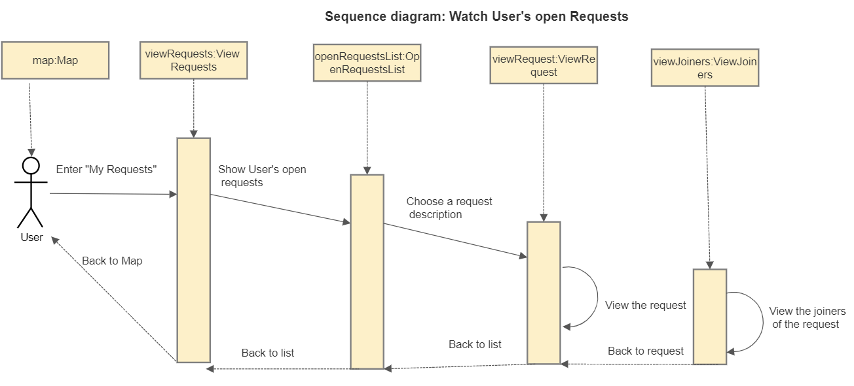
Sequence diagram

Slide 6
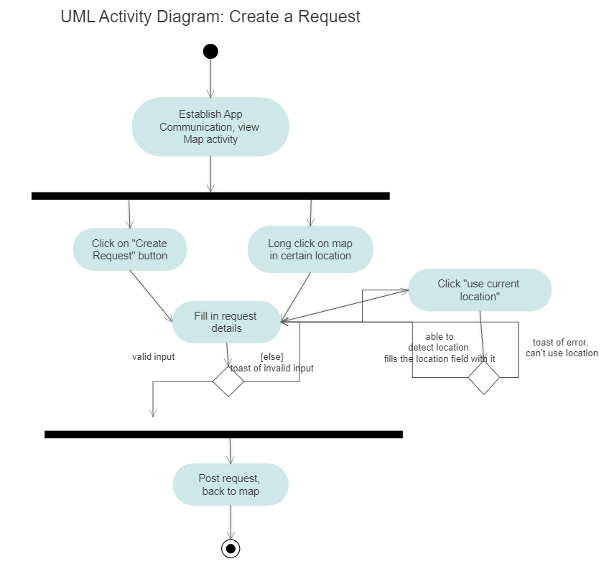
Activity diagram

Slide 7
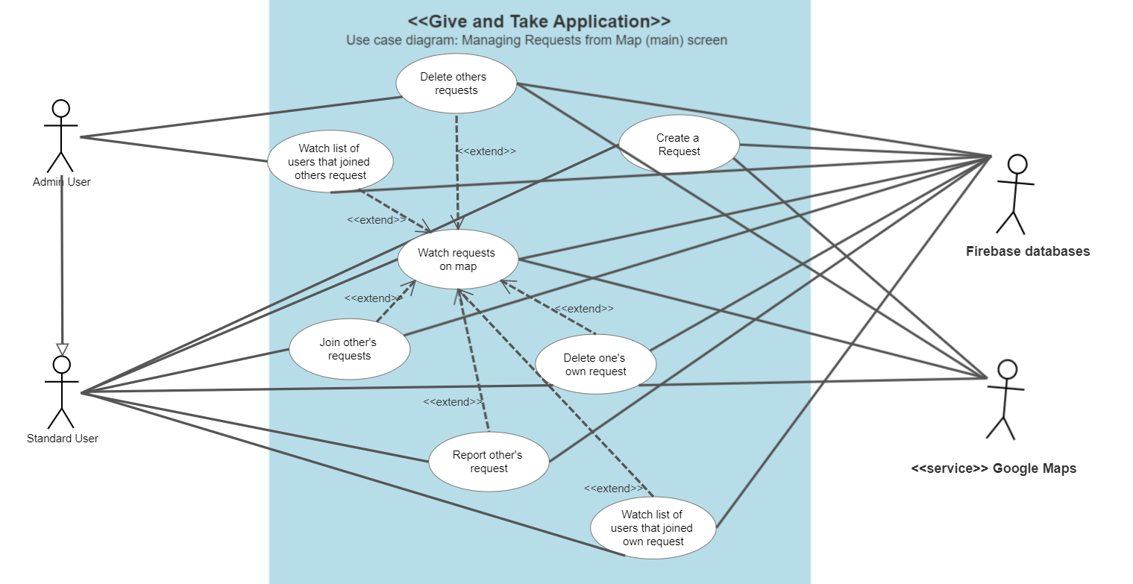
Use Case diagram

Slide 8
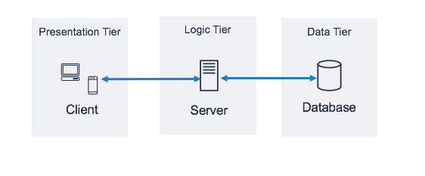

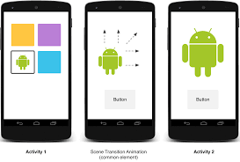





Tier architecture
Application Server.py- e.g requests uploader
Activities, Views

Slide 9
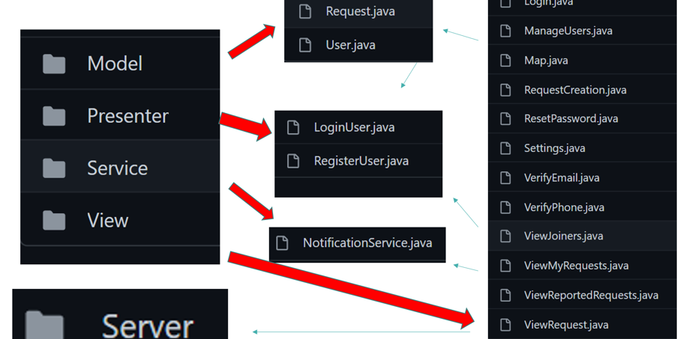
System’s flow

Slide 10
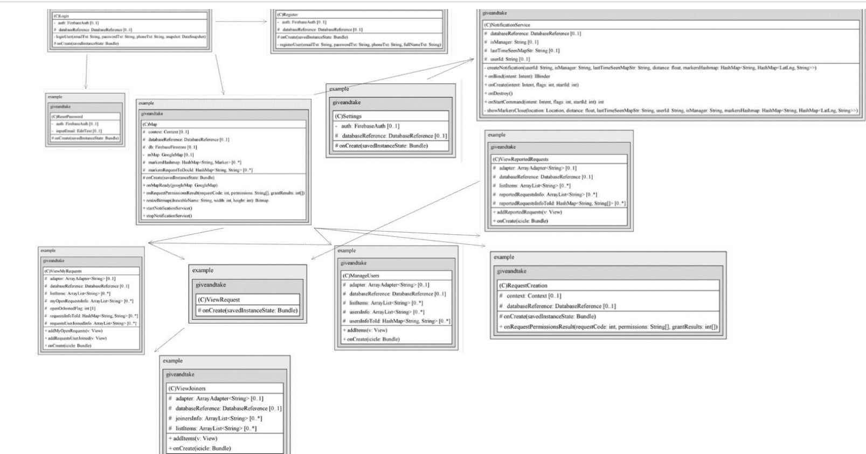
Model: User
Model: Request
All except models connect to server
System’s objects
Server: app.post(/request_details)

Slide 11
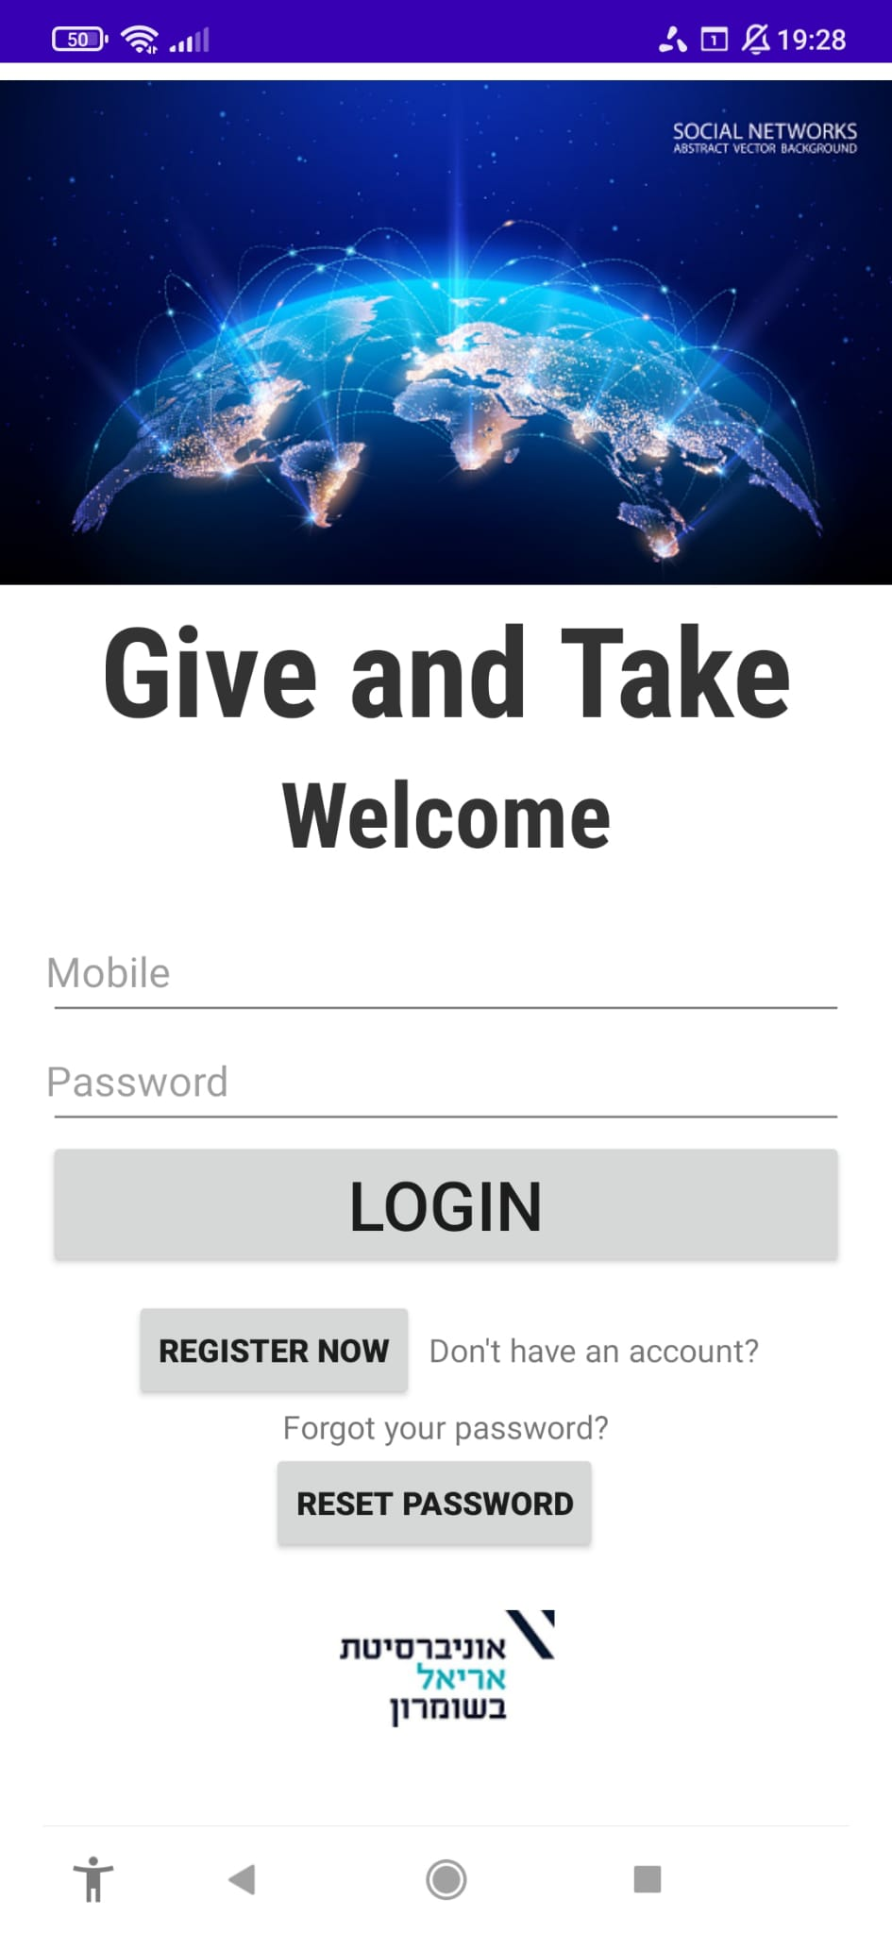
Login screen

Slide 12
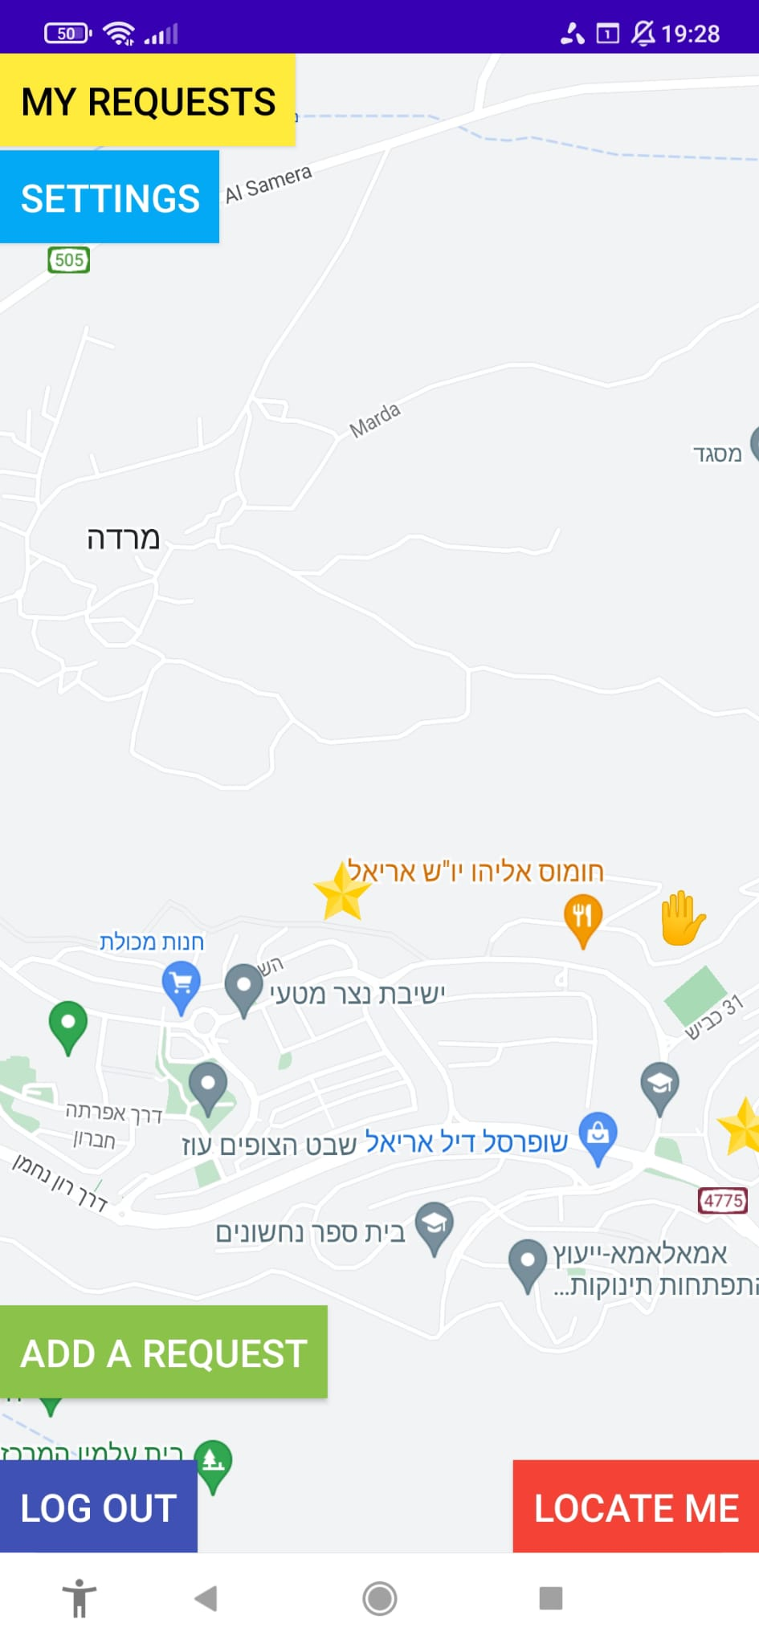
Map screen-
Standard user

Slide 13
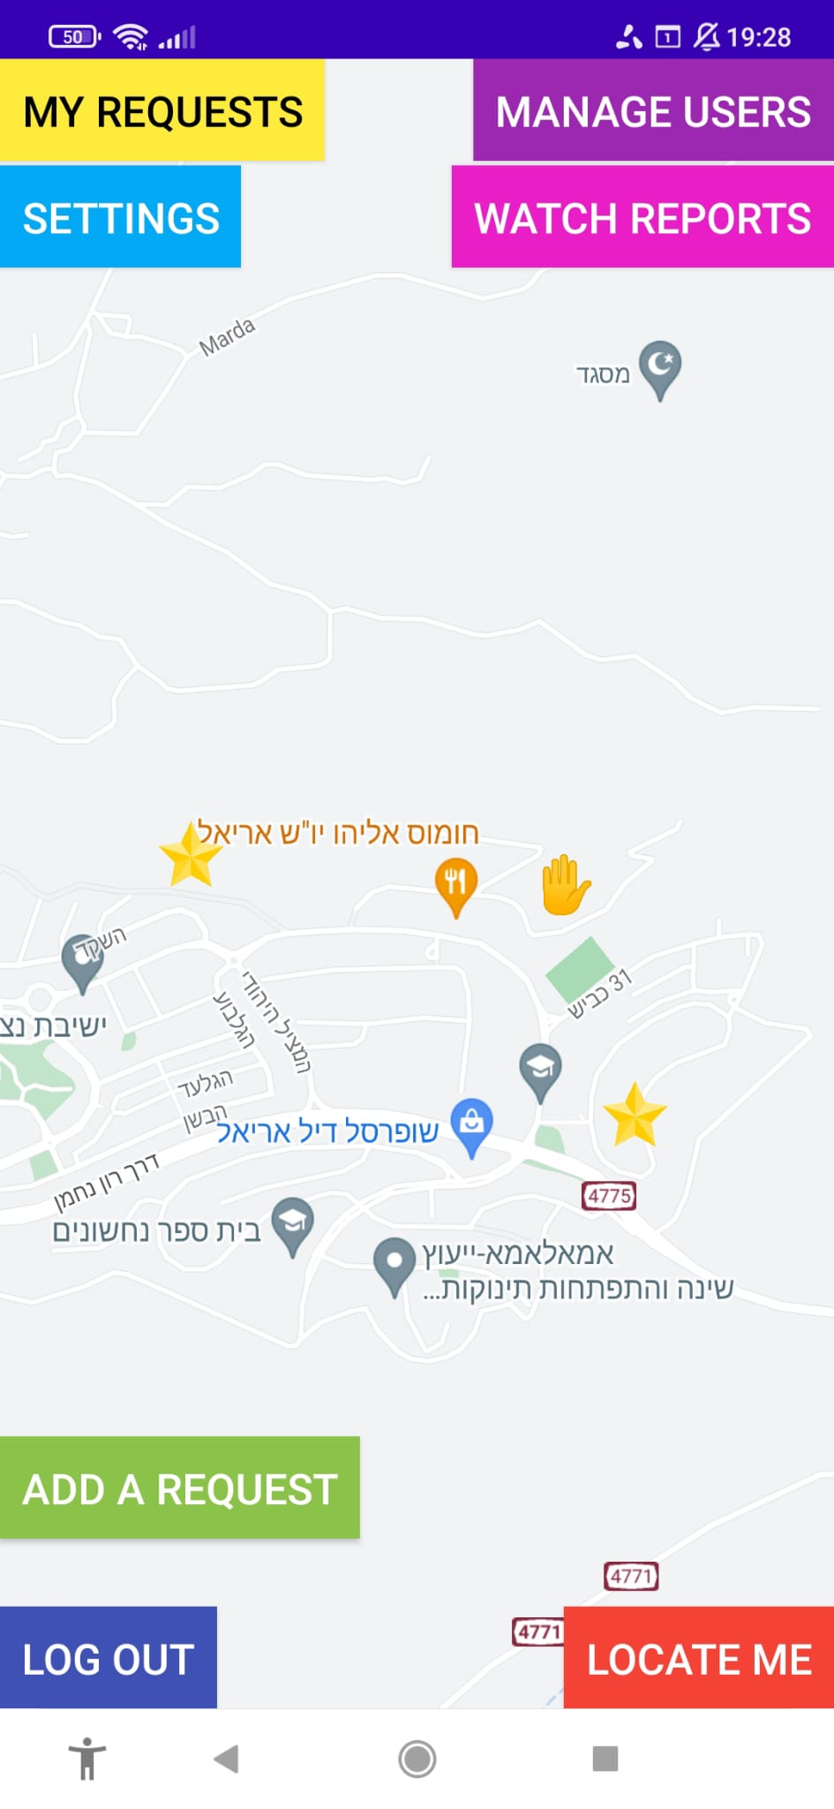
Map screen-
Admin user

Slide 14
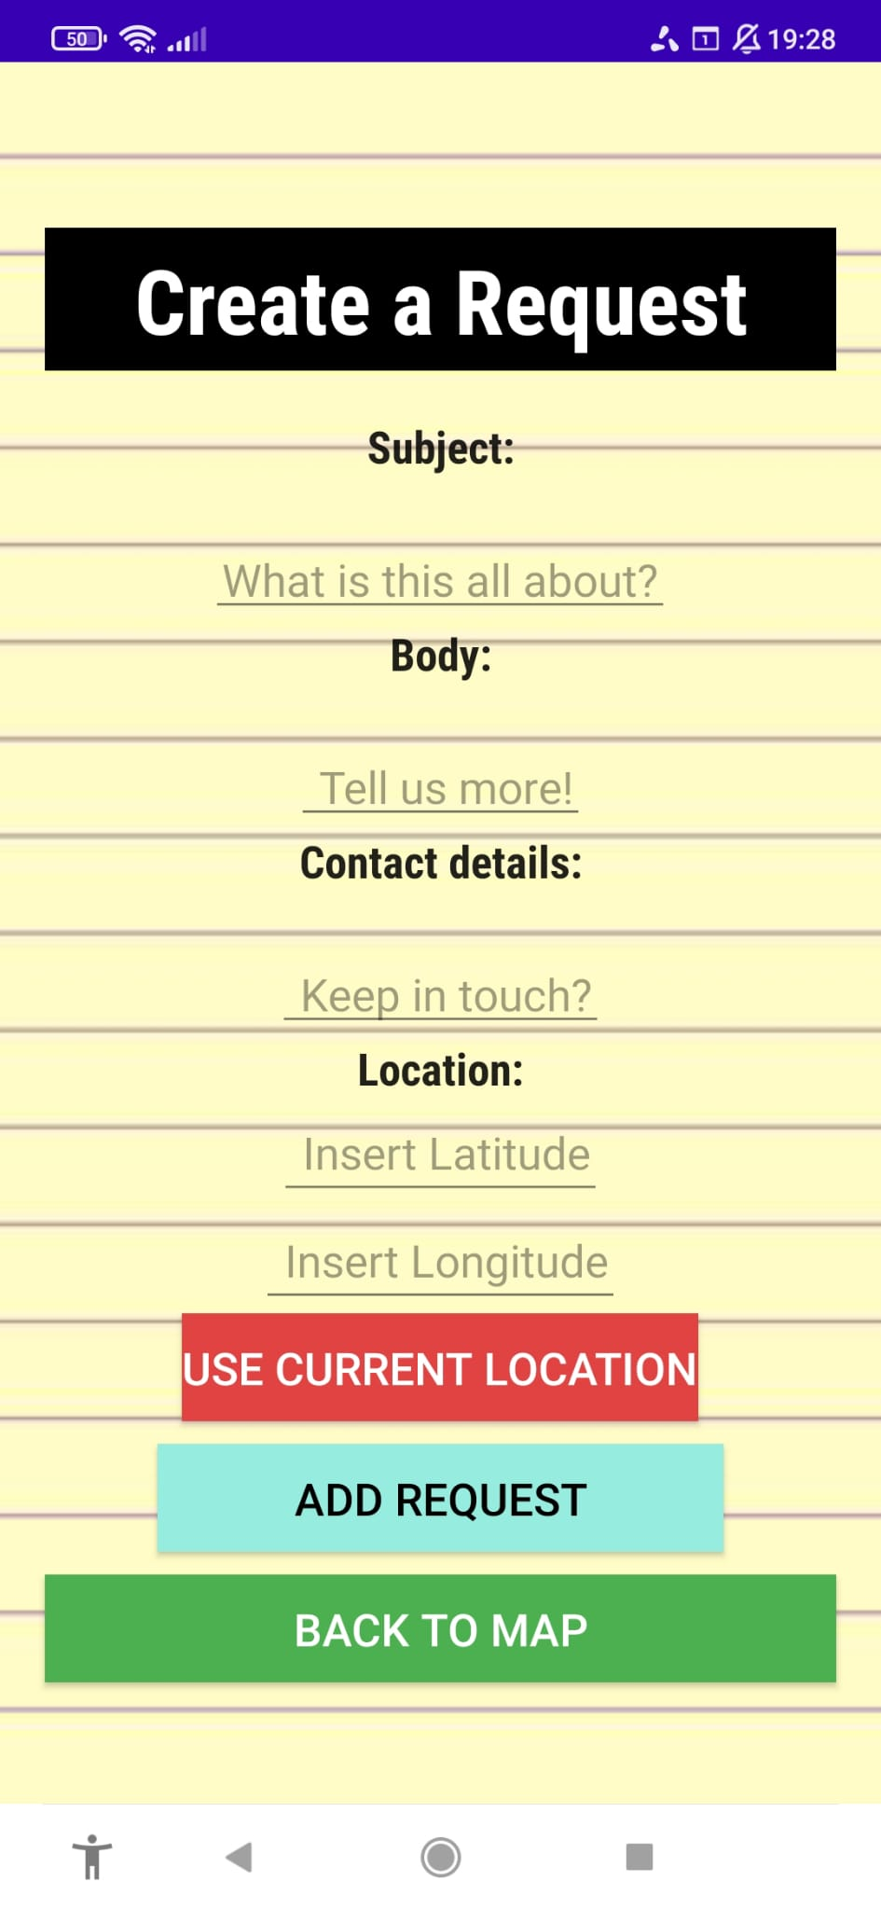
Create a request
screen

Slide 15
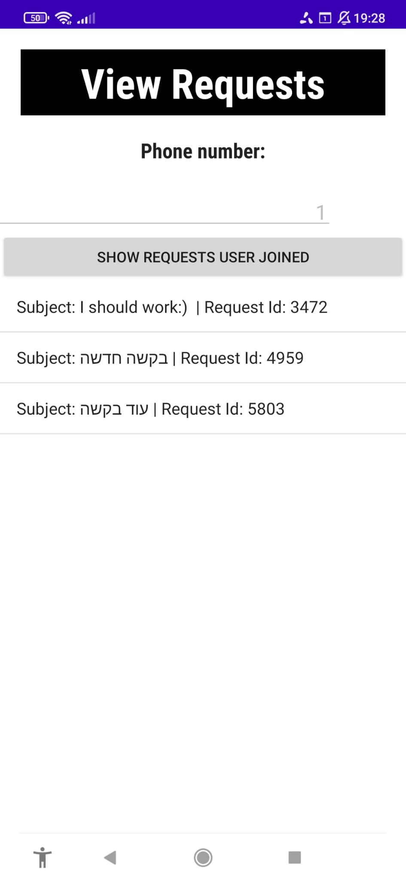
View list of user’s
requests screen

Slide 16
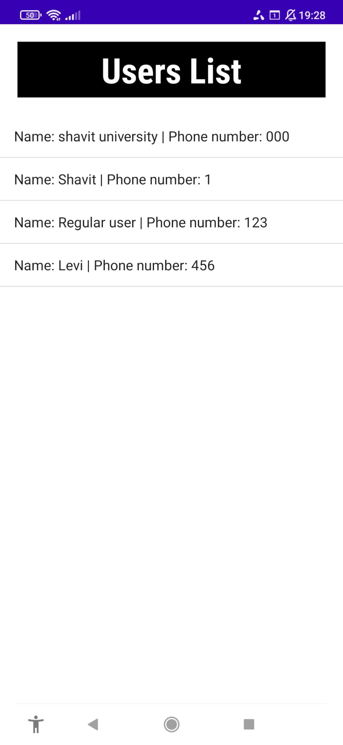
View users
list screen

Slide 17
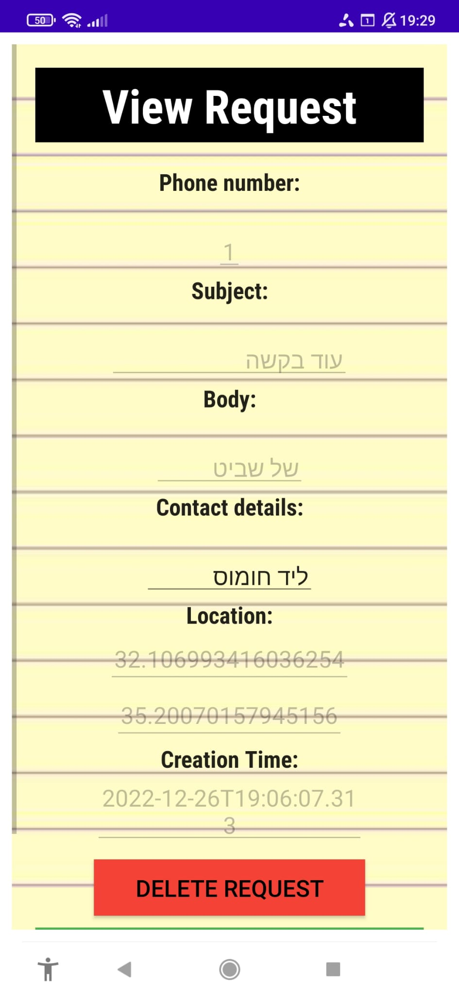
View request
screen’s top

Slide 18
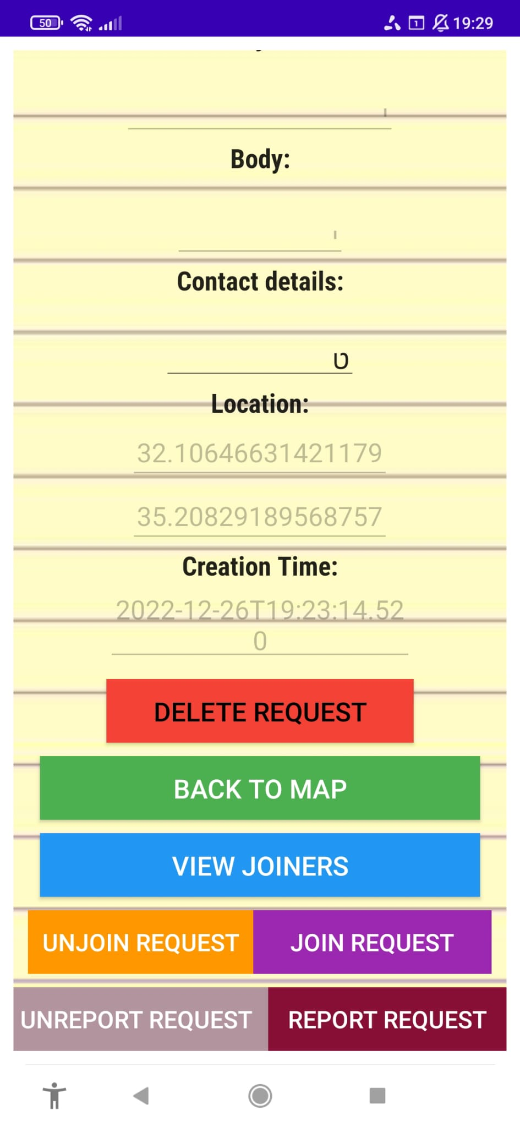
View request
Screen’s bottom

